Slide 1

Perfume Recommender
For Noon.com

Slide 2
Once upon a time…

Slide 3
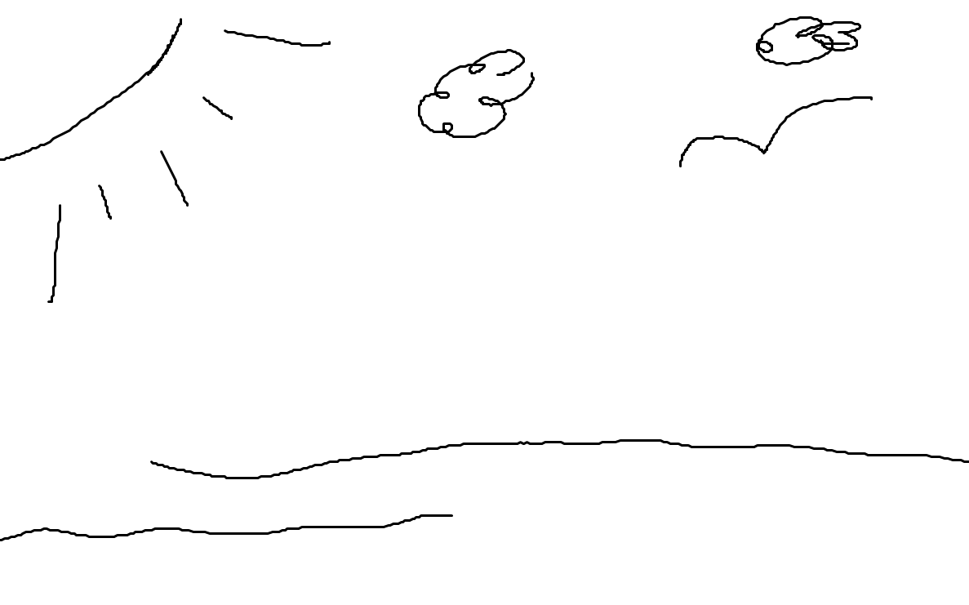

Slide 4
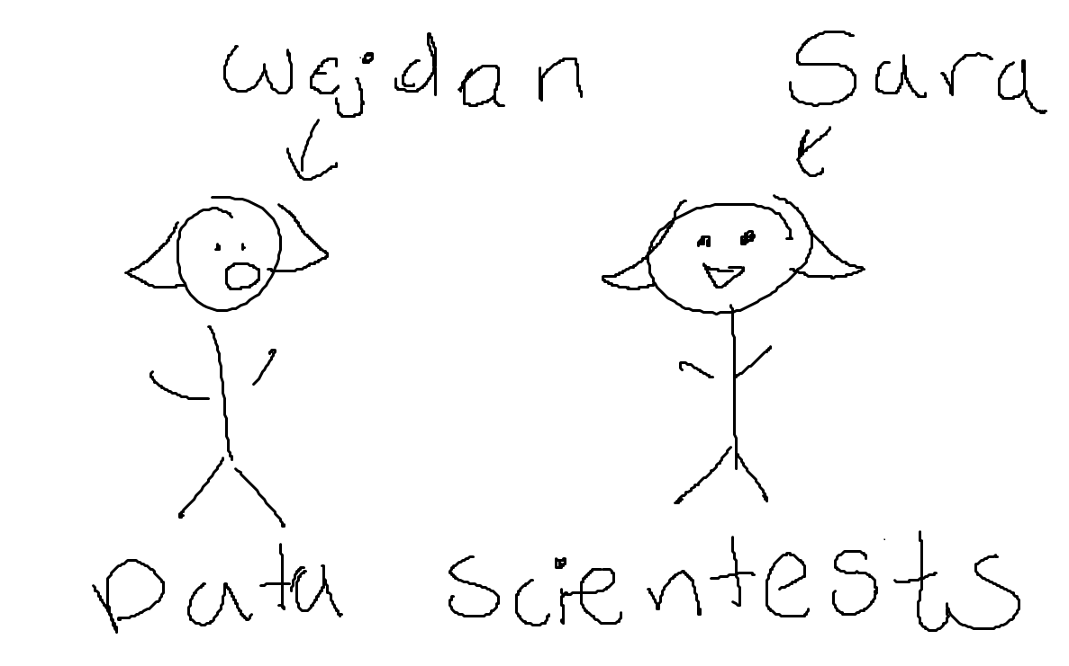

Slide 5
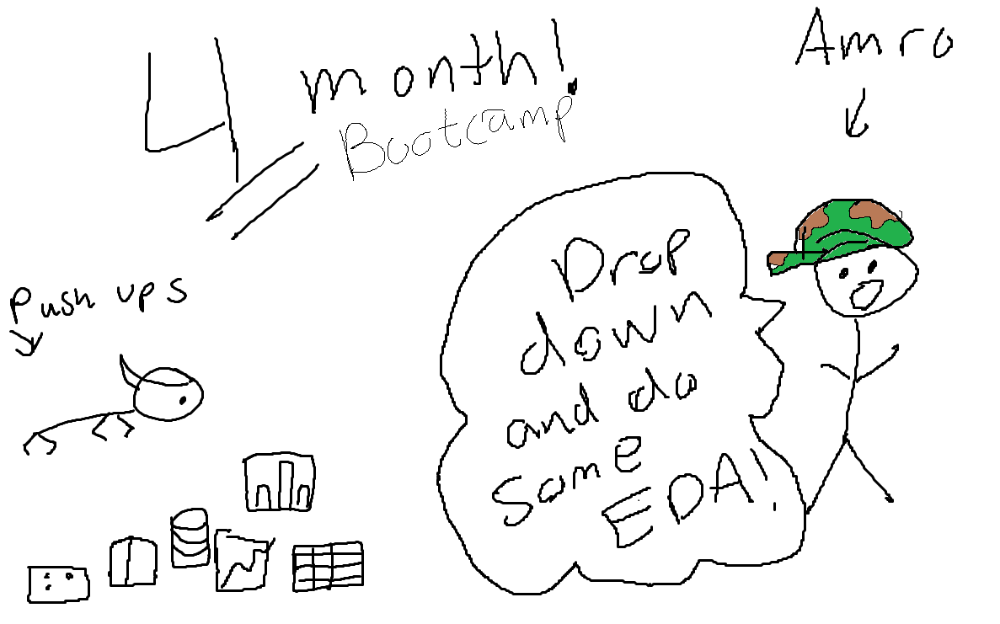

Slide 6
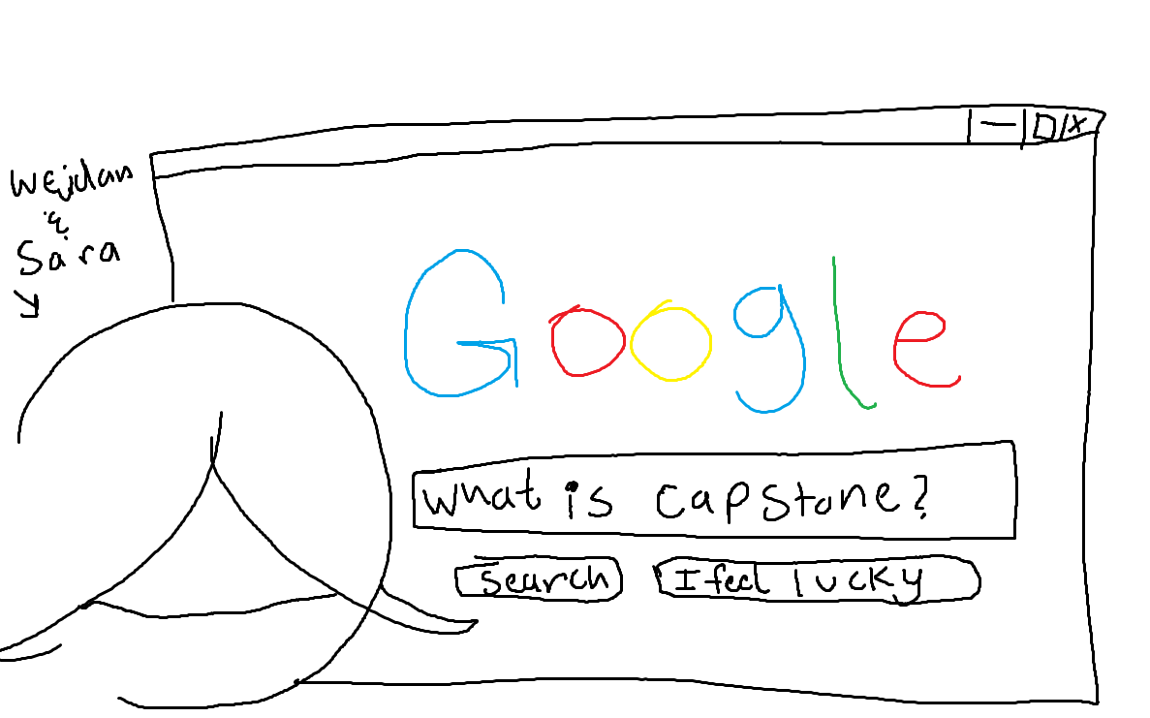

Slide 7


Slide 8
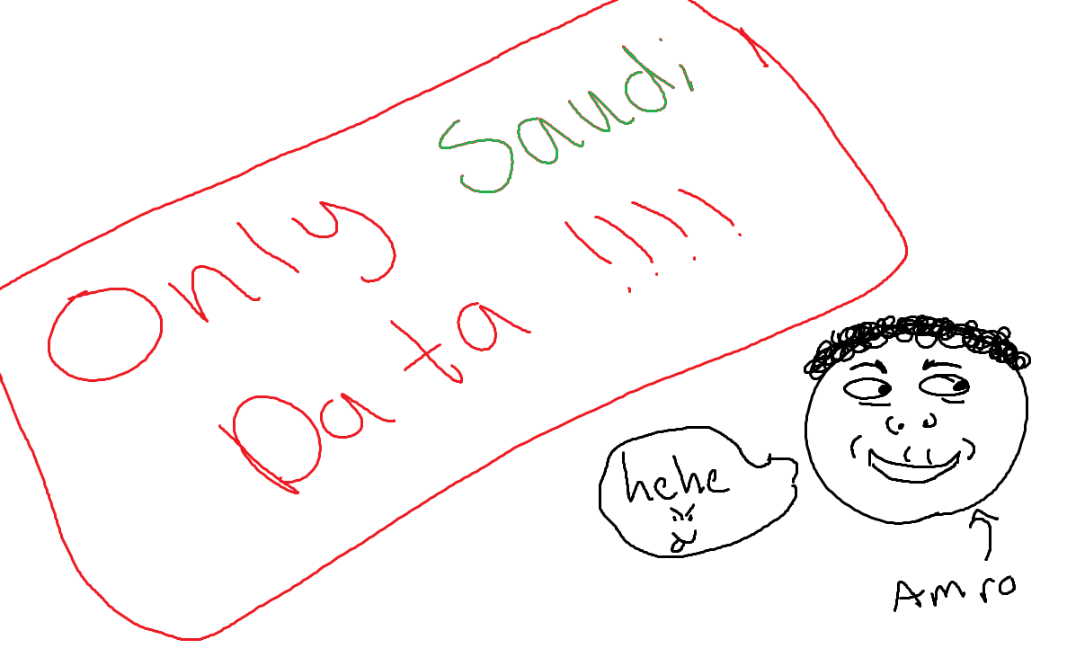

Slide 9
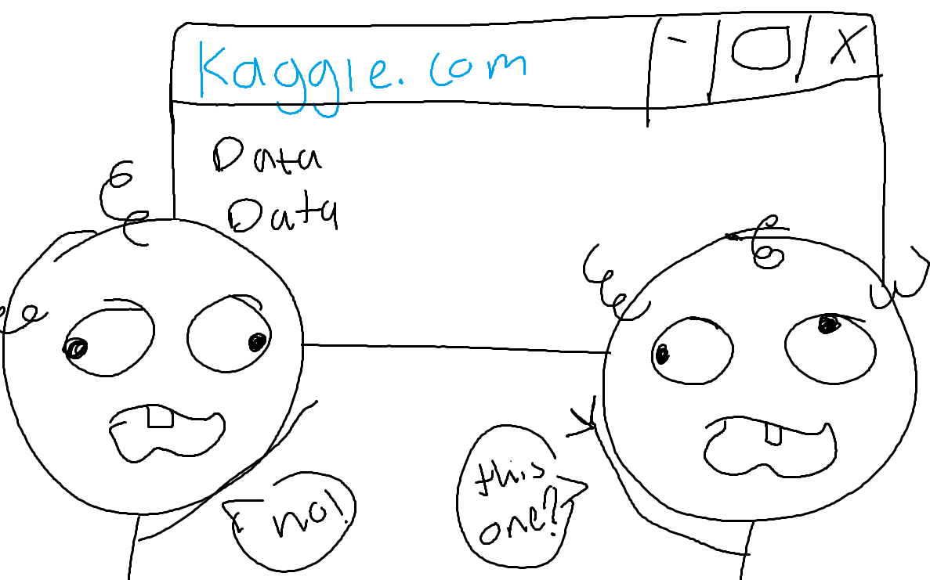

Slide 10
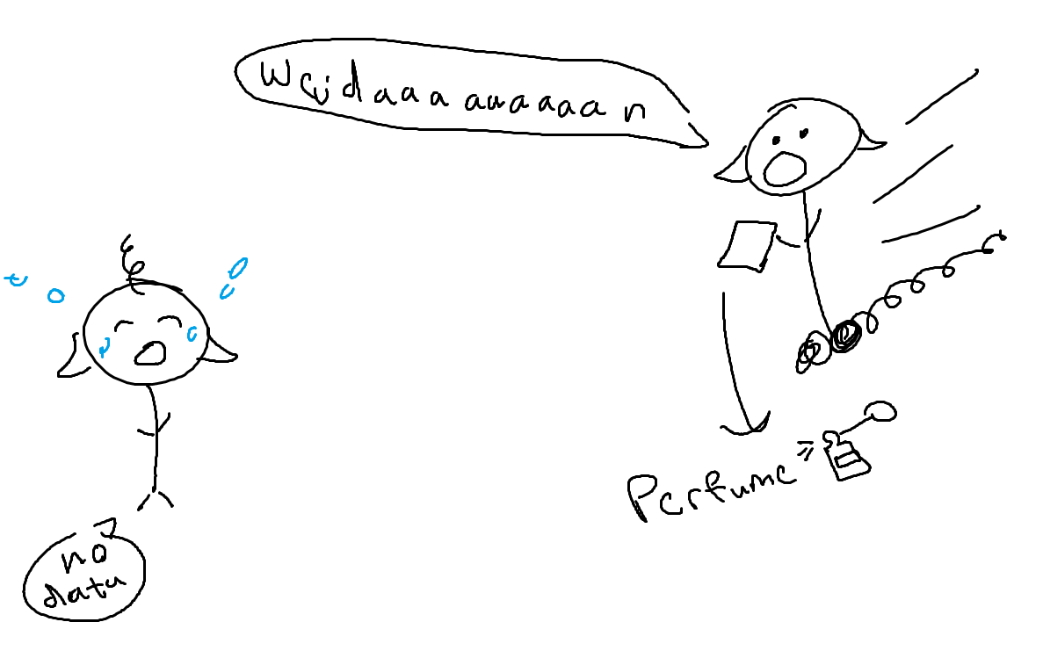

Slide 11
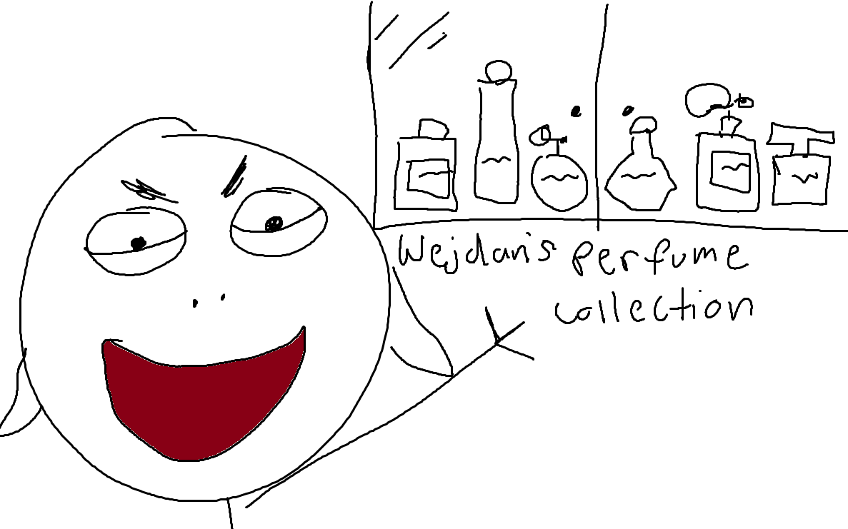

Slide 12
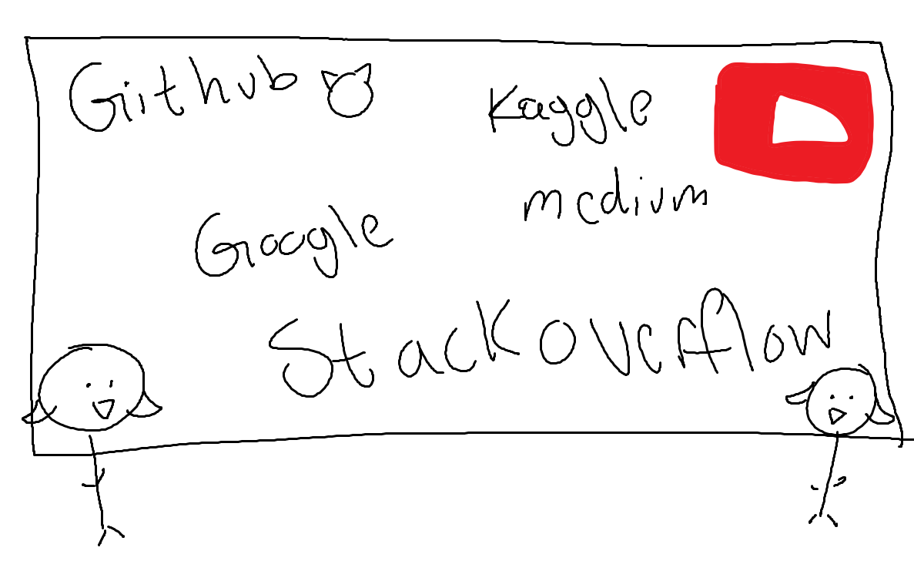

Slide 13
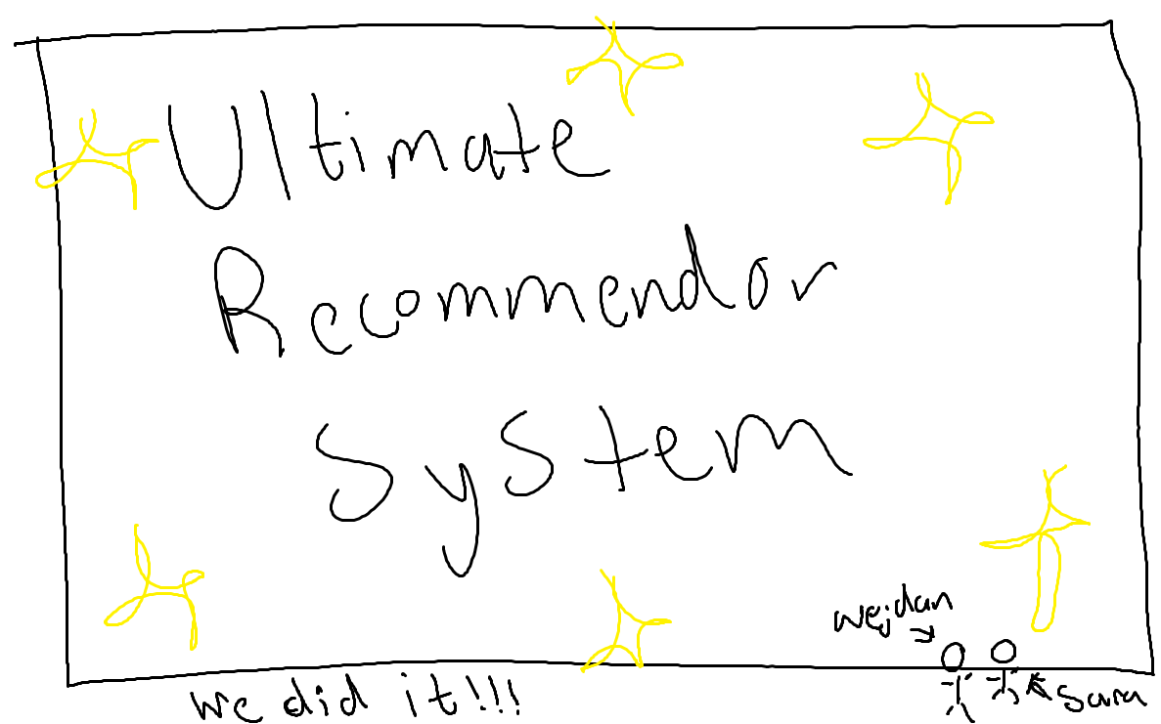

Slide 14
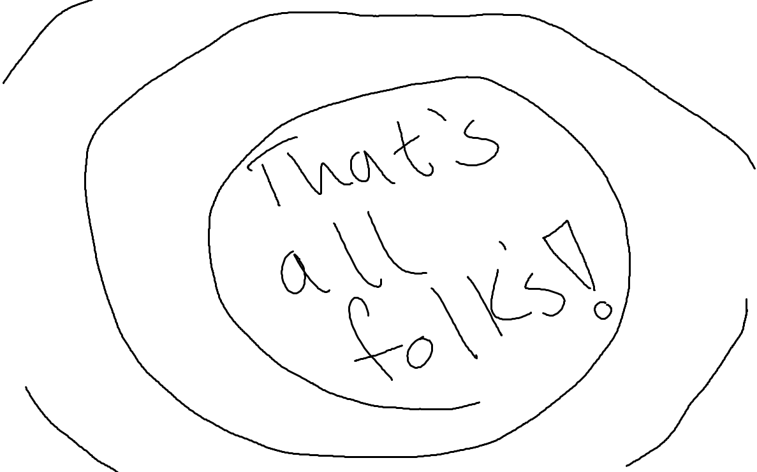

Slide 15
Video

Slide 16
Table of Contents
01
02
03
Introduction
Data Review
Data Preprocessing
A briefing of the project and the bussiness problem
An overview of the datasets used
The steps taken to prep our data

Slide 17
Table of Contents
04
05
06
EDA
Model
Results
07
Conclusion
A look into insights of the graphs
Our model and how it was built
Evaluations and results of the model
Future work

Slide 18
“No elegance is possible without perfume. It is the unseen, unforgettable, ultimate accessory.”
“
— Coco Chanel

Slide 19
01
Introduction

Slide 20



Economical Development
And How are recommender can enhance that.

Slide 21
Ecommerce in Saudi Arabia – Statistics and Trends
8.717 Million
9.784 Million
10.864 Million
Year
Estimated Revenue (USD)
2018
2019
2020

Slide 22

32%
59%
Online Buyers Demographics
Saudis
Non-Arab Immigrants

Slide 23
40%
78%
76% vs 24%
Customers return the product they ordered because they changed their mind and didn’t want it anymore.
Customers were satisfied with their online shopping experience.
76% of payments are done through cash on delivery (COD) and 24% are made through credit cards

Slide 24
Saudi Arabia has the highest amount of credit cards in the arab world, with 12.3 million cards.

Slide 25
Our solution
Match me!
Complement me!
Find the closet match to the customers selected perfume.
Find 3 complementing perfumes to the customers selected perfume.

Slide 26
02
Data Review
Scrape Noon.com Perfume data.

Slide 27
Web Scraping
The data we used was web scraped by our TA Mr. John Dailey, he used a combination of different libraries to web scrape the perfume section of the Noon.com website.
The data set has over a 100 columns and 10,000 rows.
The Most Important features are:
perfume name (categorical).
Perfume notes(top, middle, and base notes), (categorical).
Scents (categorical).
Prices. (numeric)
Bottle size (categorical).
Concentration (categorical).
Department (men, women and unisex perfumes) (categorical).
After cleaning the data, we left with 10 columns and 5000+ rows

Slide 28
03
Data Preprocessing
Cleaning and organizing the dataset.

Slide 29
General Cleanup
Merge Datasets
Select Columns
General Cleanup
Handling Duplicate
Handling Inconsistency
Split Column
1
2
3
Join the perfume info data with the links/prices data by the link
Select needed columns, such as (name, price, notes columns, size, and links)
Removing weird symbol, adding a comma between each note value
4
5
6
Sort and fill Nan values, then remove the duplicate values
Fixing the links, spelling mistakes, removing stop words, and unifying sizes
Split the name column into (name, concentration), and fill Nan values in the size from the name

Slide 30
Cleanup To Build The Model
Handling Nan Values
Popularity Column
Handling notes columns
1
Replace Nan with empty string.
2
Based on the counts of scents we select a random number from specific range for popularity , the higher the count the higher the popularity range.
3
Gather the notes for each row into a list

Slide 31
Before and after data preprocssing
 | Name | Size | price | Department | Scents | Top Note | Heart/Middle Note | Base Note | concentration
Befor cleaning | Pierra Katra Cute Rouge EDP 100 Millilitre | 100 Millilitre | 95.0 | Unisex | Woody | Nan | Tuberose, Orange Blossom, Ylang-Ylang, Jasmine Sambac, Cashmeran And a hint of Benzoin | Tuberose, \x0Amber and Others
After cleaning | Pierra Katra Cute Rouge | 100ml | 95.0 | Unisex | Woody | Nan | tuberose,orangeblossom,ylangylangg,jasminesambac,cashmeran,benzoin | tuberose,amber | EDP
Cleaning for Model | Pierra Katra Cute Rouge | 100ml | 95.0 | Unisex | [Woody] |  | [tuberose,orangeblossom,ylangylangg,jasminesambac,cashmeran,benzoin] | [tuberose,amber] | EDP

Slide 32
04
Data Exploration
Exploratory data analysis

Slide 33

Insights
The dominating scents are floral and woody, and a lot of the spicy and Arabian scents are also popular which was expected based on regional preference.

Slide 34

Insights
The perfume departments with women leading with a 47% followed by Unisex with 33% and Men at 18%.
Most of the perfumes in our dataset have an EDP concentration, this is the most popular type of concentration for perfumes in general.

Slide 35
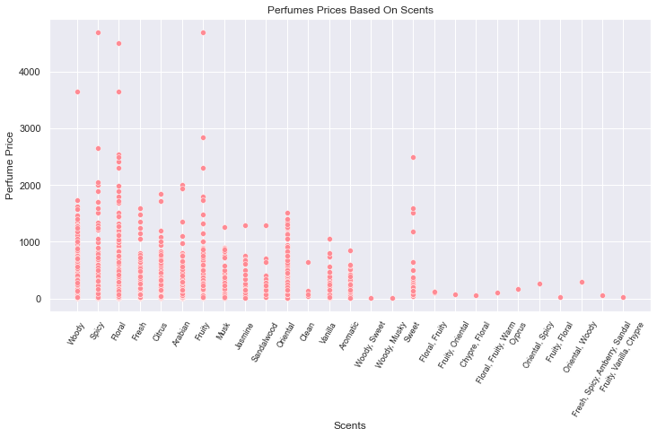
Insights
Most of the perfumes have a price less than 2000 SR. The scents with a high price are (woody, spicy, floral, fruity, and sweet).

Slide 36
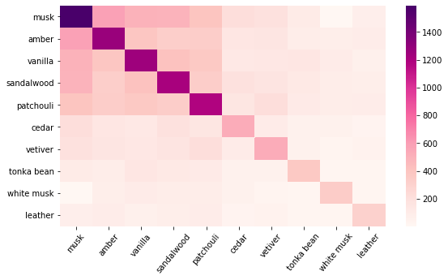
Insights
the top left corner of the base notes have a strong correlation, which means those notes are most commonly found together in a perfume bottle.

Slide 37
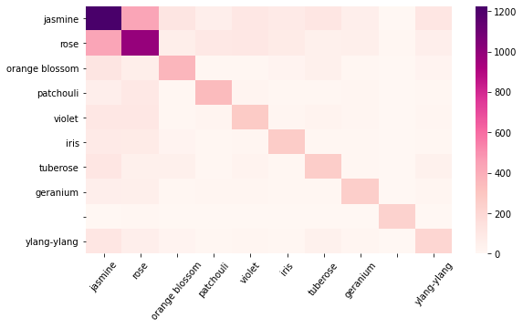
Insights
The middle notes don’t have a strong correlation as much as the base notes do, rose and jasmine seem to be the only ones that are frequently together in a perfume, as they complement each other nicely.

Slide 38


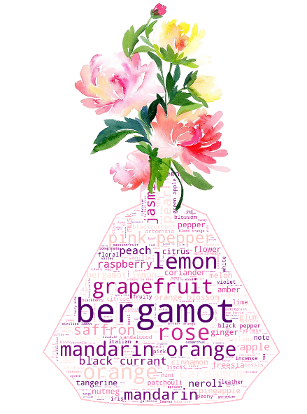
Insights
In these word clouds we can see the most prominent notes in each of the base, middle, and top notes.
Top Notes
Base Notes
Middle Notes

Slide 39
Dashboard

Slide 40
05
Model

Slide 41
Model Pipeline
Cold start
Considering Data
Content Filtering
Feature Extraction

Slide 42
Model Pipeline
Model
Convert Features
Cosine Similarity
Perfume name Input
Index Perfume
Related rows/columns
Sort, Return top matches
Filter by department

Slide 43
Model Variations
 | Data transformation | Selected Features
Model 1 | TFIDF | Base Notes
Model 2 | Binary Matrix | Base Notes
Model 3 | Binary Matrix | Top Notes
Model 4 | Binary Matrix | Middle Notes
Model 5 | Binary Matrix | All Notes
Model 6 | Binary Matrix | All Notes+Popularity

Slide 44
Dataset Preparation
 | Description
Dataset 1 | This dataset has 5192 total records, but has a lot of nulls that we kept and replaced with an empty string.
Dataset 2 | This dataset has 2320 records we have removed all the nulls from the features we are training our models on.
Dataset 3 | This data is a 100-record sample of the original data.
Dataset 4 | This data is a different dataset from the one web scraped, it is a 1002 record dataset from Kaggle with no nulls.

Slide 45
Demo

Slide 46
06
Results

Slide 47
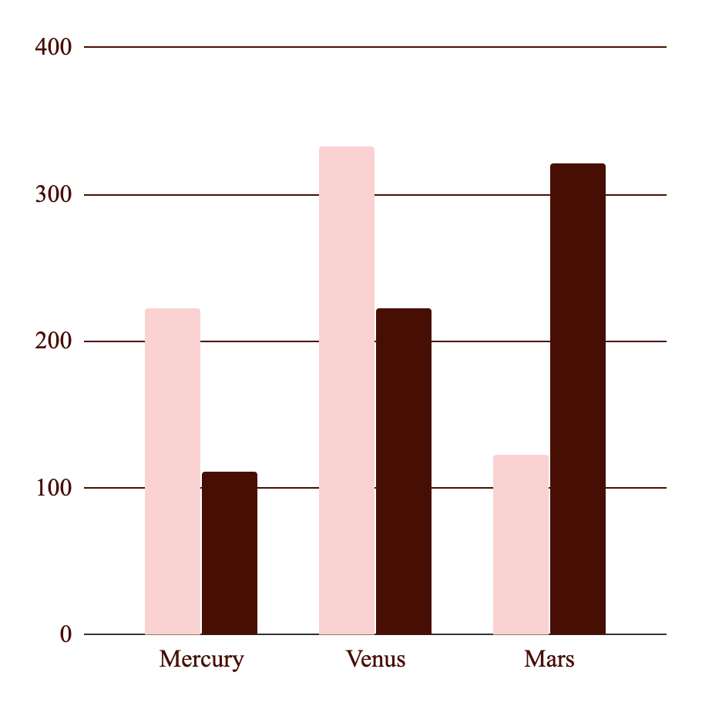
Evaluation Metric
For evaluating our model, the appropriate metric we found was the coverage percentage, which is defined as the percentage that our model’s predictions can cover from the overall dataset.

Slide 48
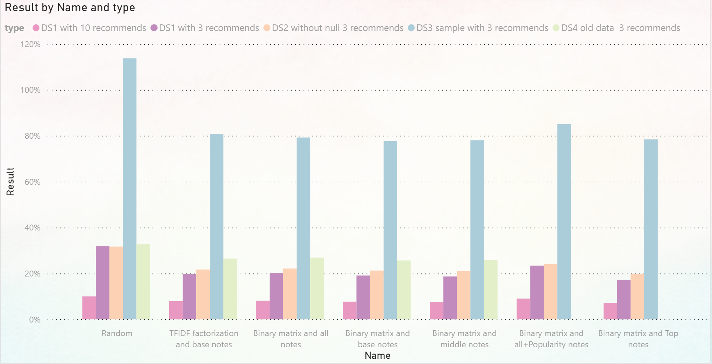
Model Results

Slide 49
Model Results
Higher Input, Lower Output
Features matter!
Not Enough data
The higher the number of recommendations and the input data the lower the coverage percentage.
Adding the popularity feature to the models enhanced them all by 5%. The models that performed the best were the ones that were trained on all features.
Our results could be due to the data fed into the model, there is a lack of similarity between perfumes.

Slide 50

Model Results
Dirty Data
Nature of recommendors
A contributing factor could be that the data, there were several “outlier” note features that would affect the perfumes recommendation.
Since recommenders only give the top matched results, this can cause redundancy in the recommended products.

Slide 51
07
Conclusion
Conclusion and future work

Slide 52
Conclusion
In our presentation, we covered a content filtering approach to recommender systems, based on the data we had. We learned that while content-based filtering has its pros and solves many solutions it is not robust in handling a large number of items.

Slide 53


Future Work
Collect more data related to the users.
Experiment more with different algorithm such as (k-Nearest Neighbors)
Incorporating time into a recommender system
Find the relationship between other categories of products the user's liked to the perfumes the model would recommend.

Slide 54
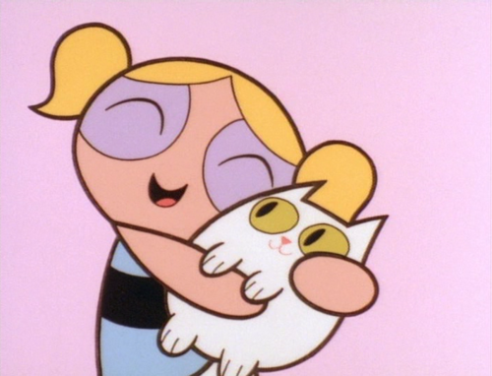
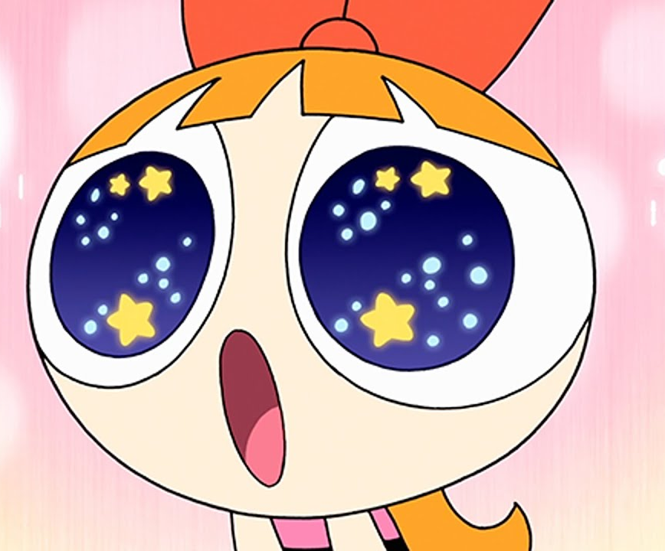
Our Team: Power Puff Girls
Wejdan Al-Ahmadi
Sara Aldubaie

Slide 55
Thanks!
Do you have any questions?

